Slide 1
Hestia’s Kitchen App Design
Amirtha Rajan PKS

Slide 2
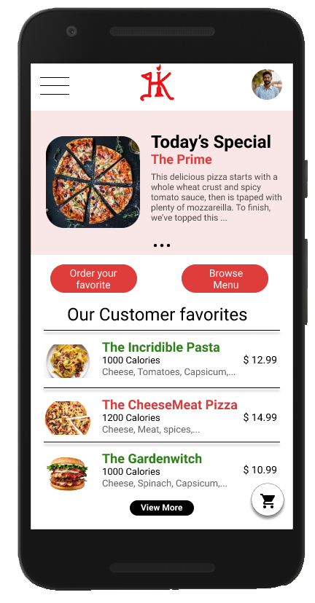
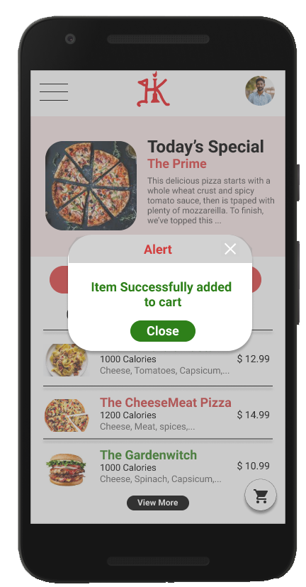
Project overview
The product:
Hestia’s Kitchen App is a Italian cusine maker located in the Ney York. Hestia’s Kitchen strives to deliver healthy, specialty italian delights and servings. They offer a wide spectrum of competitive pricing. Hestia’s Kitchen targets customers like commuters and workers who lack the time or ability to prepare a food at home..
Project duration:
May 2021 to June 2021.

Slide 3
Project overview
The problem:
Busy workers and commuters lack the time necessary to prepare a meal.
The goal:
Design an app for Hestia’s Kitchen that allows users to easily customize and order or schedule fresh, healthy dishes.

Slide 4
Project overview
My role:
UX designer designing an app for Hestia’s Kitchen from conception to delivery.
Responsibilities:
Conducting interviews, paper and digital wireframing, low and high-fidelity prototyping, conducting usability studies, accounting for accessibility, and iterating on designs.

Slide 5
Understanding
the user
User research
Personas
Problem statements
User journey maps

Slide 6
User research: summary
I conducted interviews and created empathy maps to understand the users I’m designing for and their needs. A primary user group identified through research was working adults who don’t have time to cook meals.
This user group confirmed initial assumptions about Hestia’s Kitchen customers, but research also revealed that time was not the only factor limiting users from cooking at home. Other user problems included obligations, interests, or challenges that make it difficult to get groceries for cooking or go to restaurants in-person.

Slide 7
User research: pain points
1
2
3
Time
Accessibility
IA
Working adults are too busy to spend time on meal prep
Platforms for ordering food are not equipped with assistive technologies
Text-heavy menus in apps are often difficult to read and order from

Slide 8
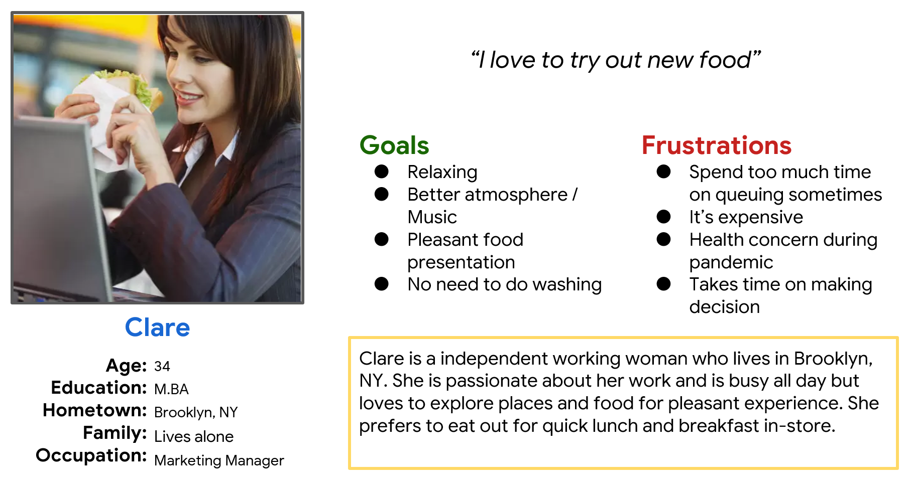
Persona: Clare
Problem statement:
Clare is a busy working adult who loves to order Italian cuisine food because they have no time to cook dinner for herself.

Slide 9
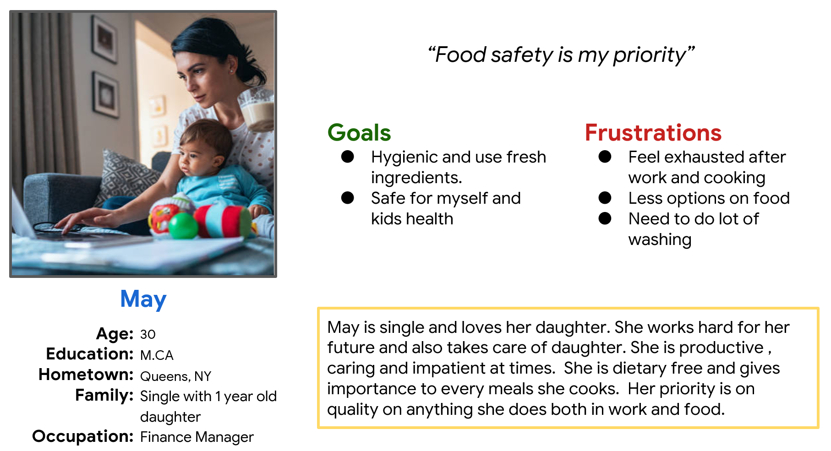
Persona: May
Problem statement:
May is a busy working Mom who is so consious about healthy food, and cooks mostly and eat home food.

Slide 10
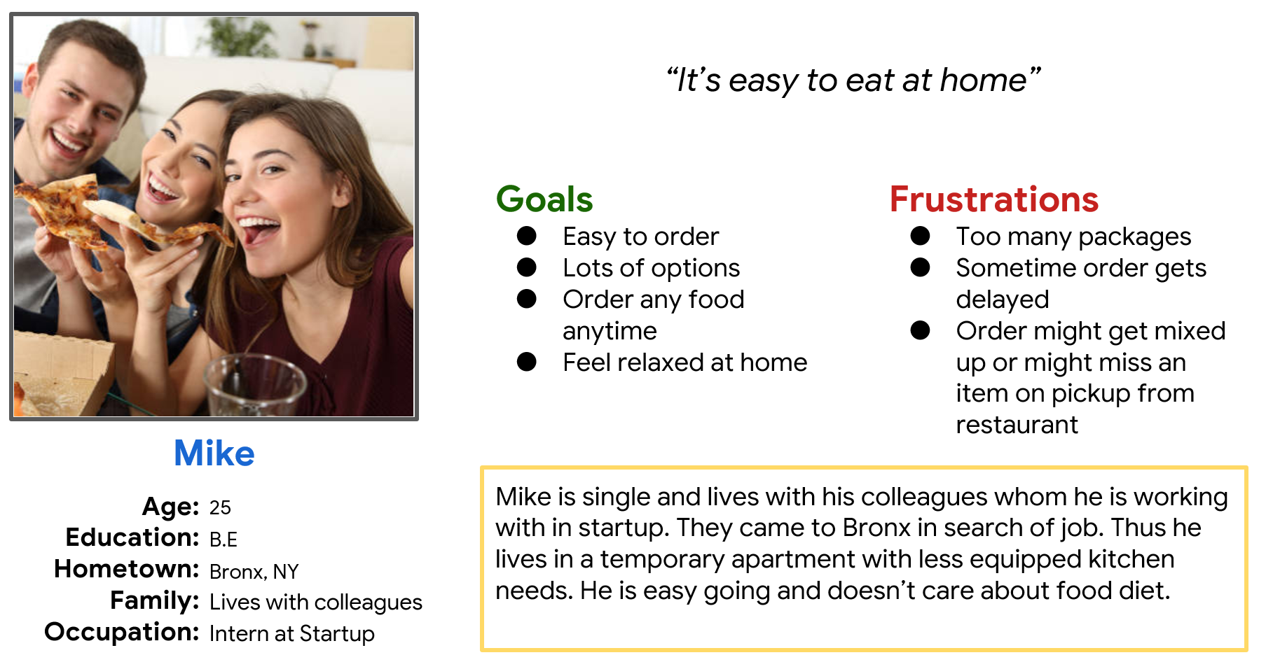
Persona: Mike
Problem statement:
Mike is a busy working allday with his collegues with who he lives in appartment. He loves ordering food especially italian cuisines which he has with his mates.

Slide 11
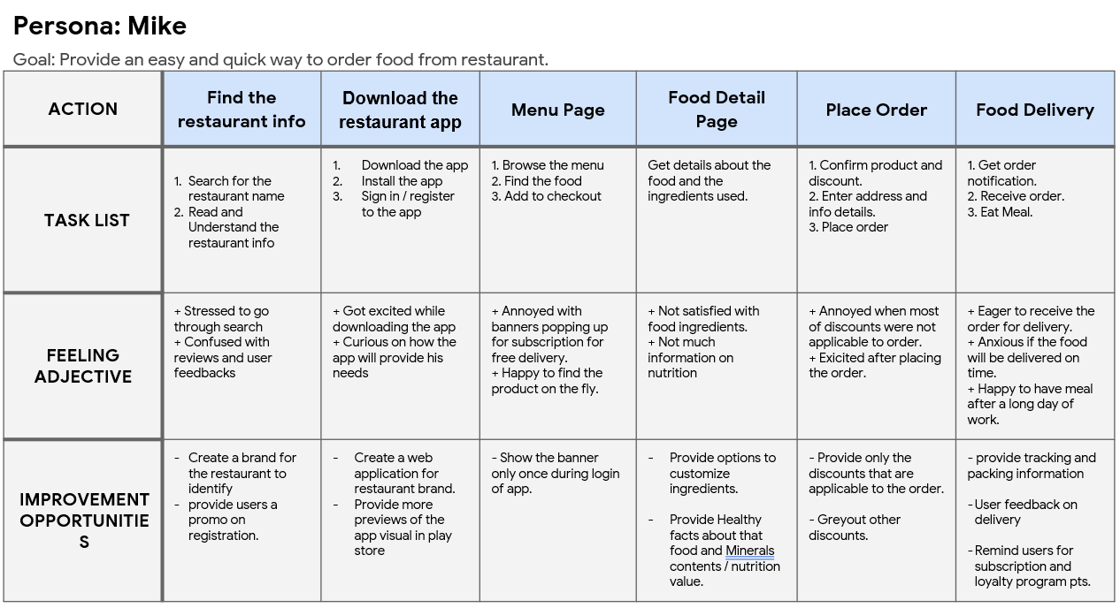
User journey map
Mapping Mike’s user journey revealed how helpful it would be for users to have access to a dedicated Hestia’s Kitchen app.

Slide 12
Starting
the design
Paper wireframes
Digital wireframes
Low-fidelity prototype
Usability studies

Slide 13
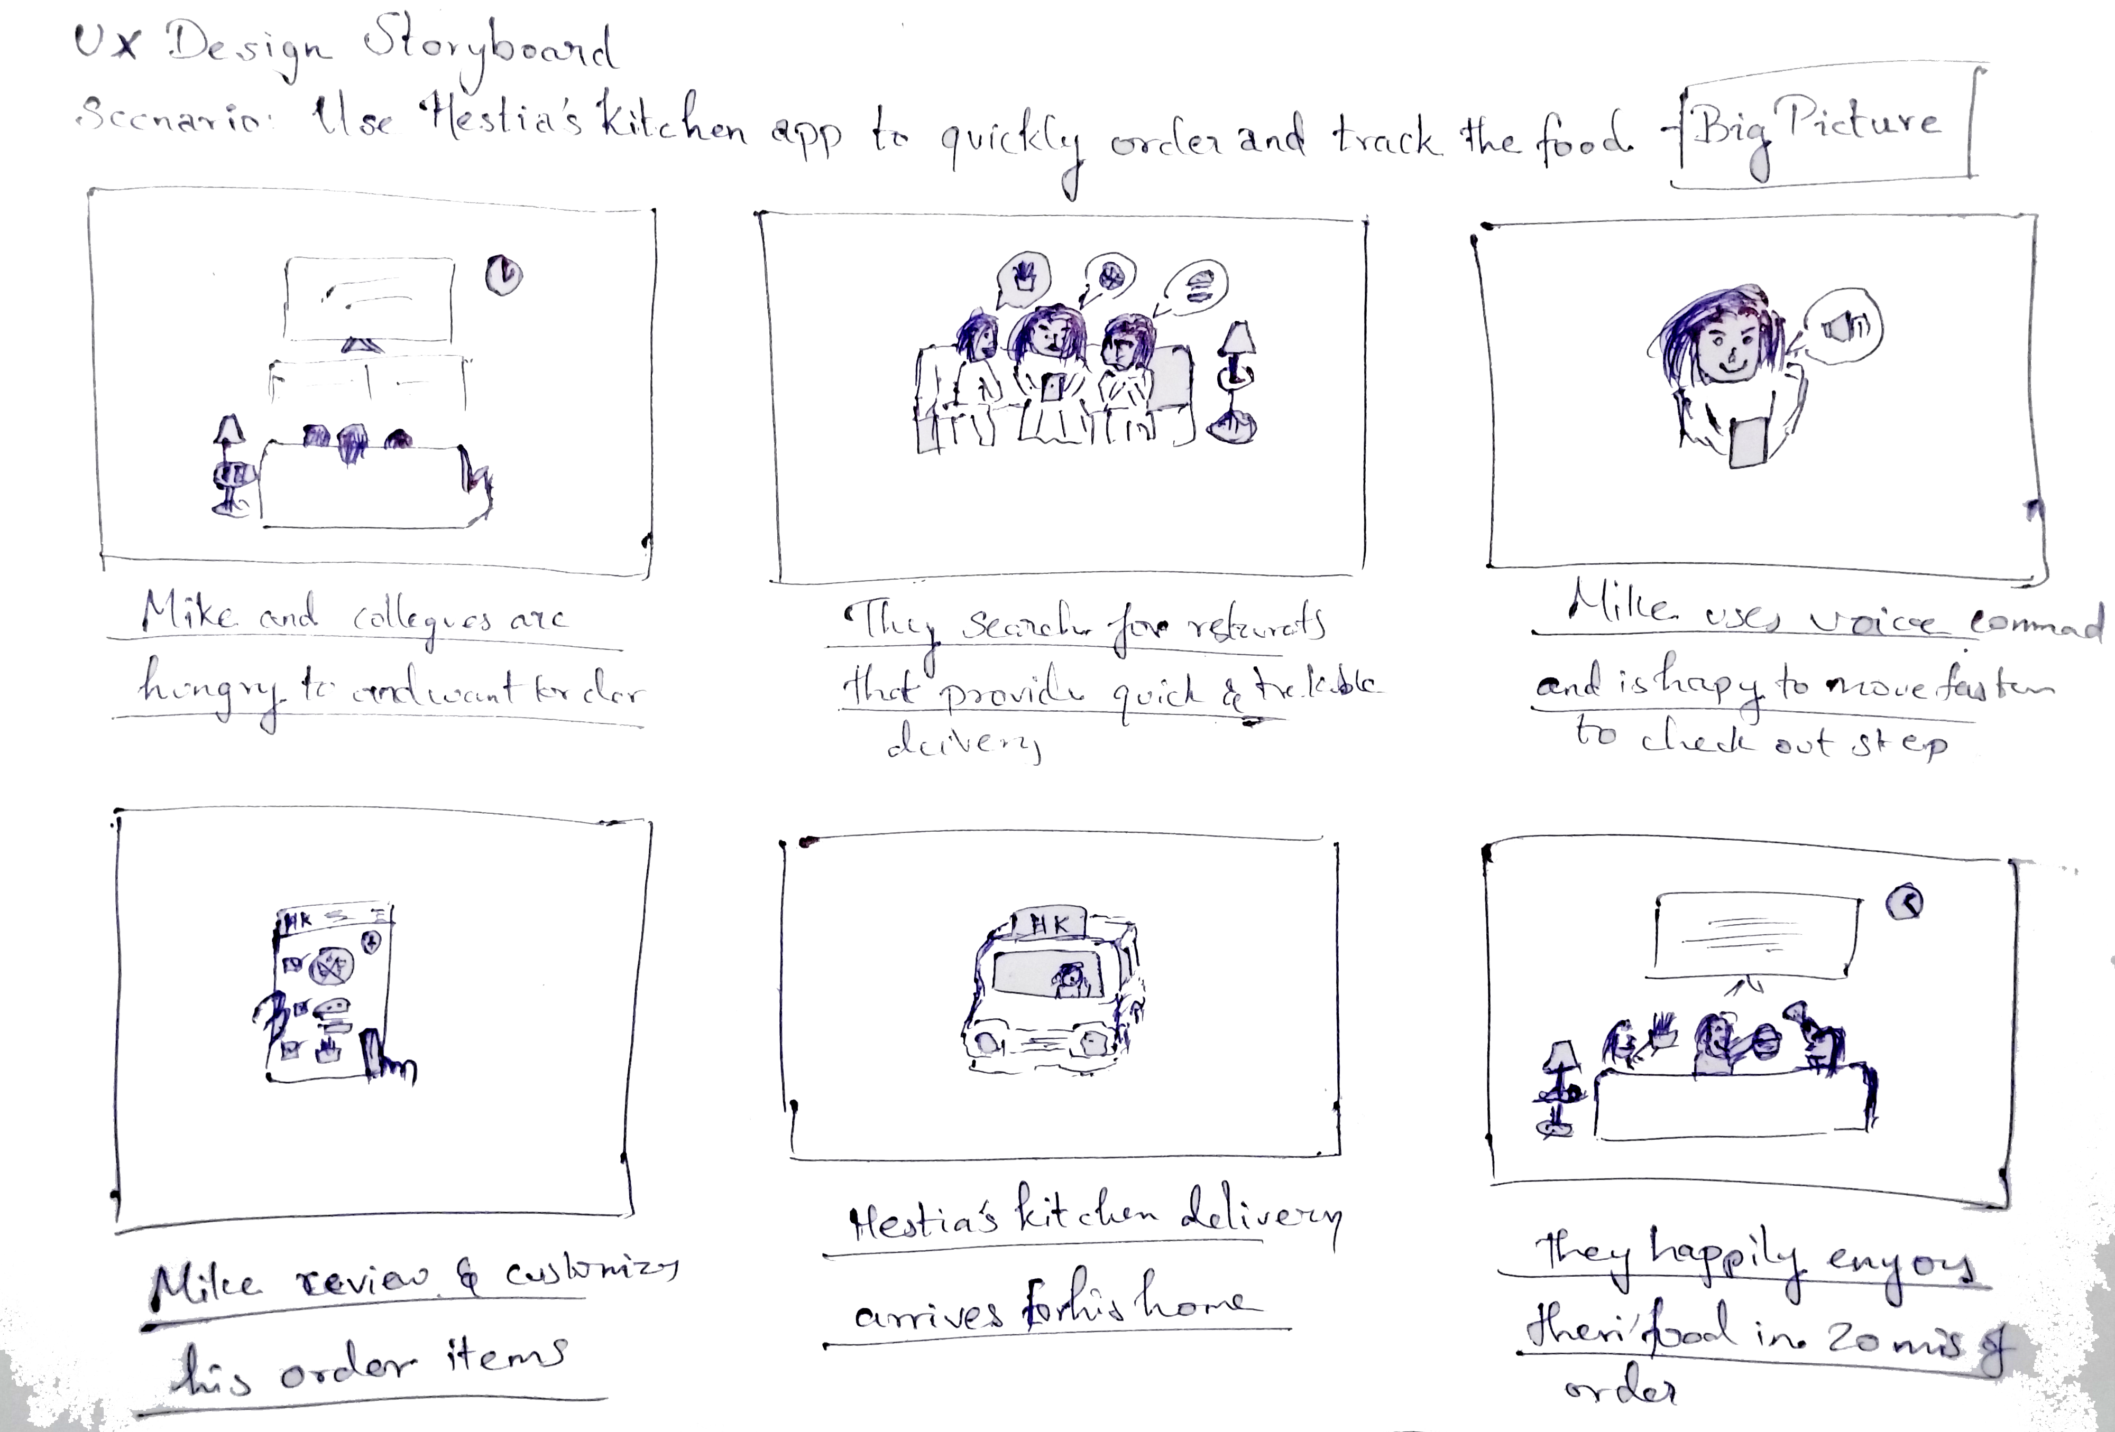
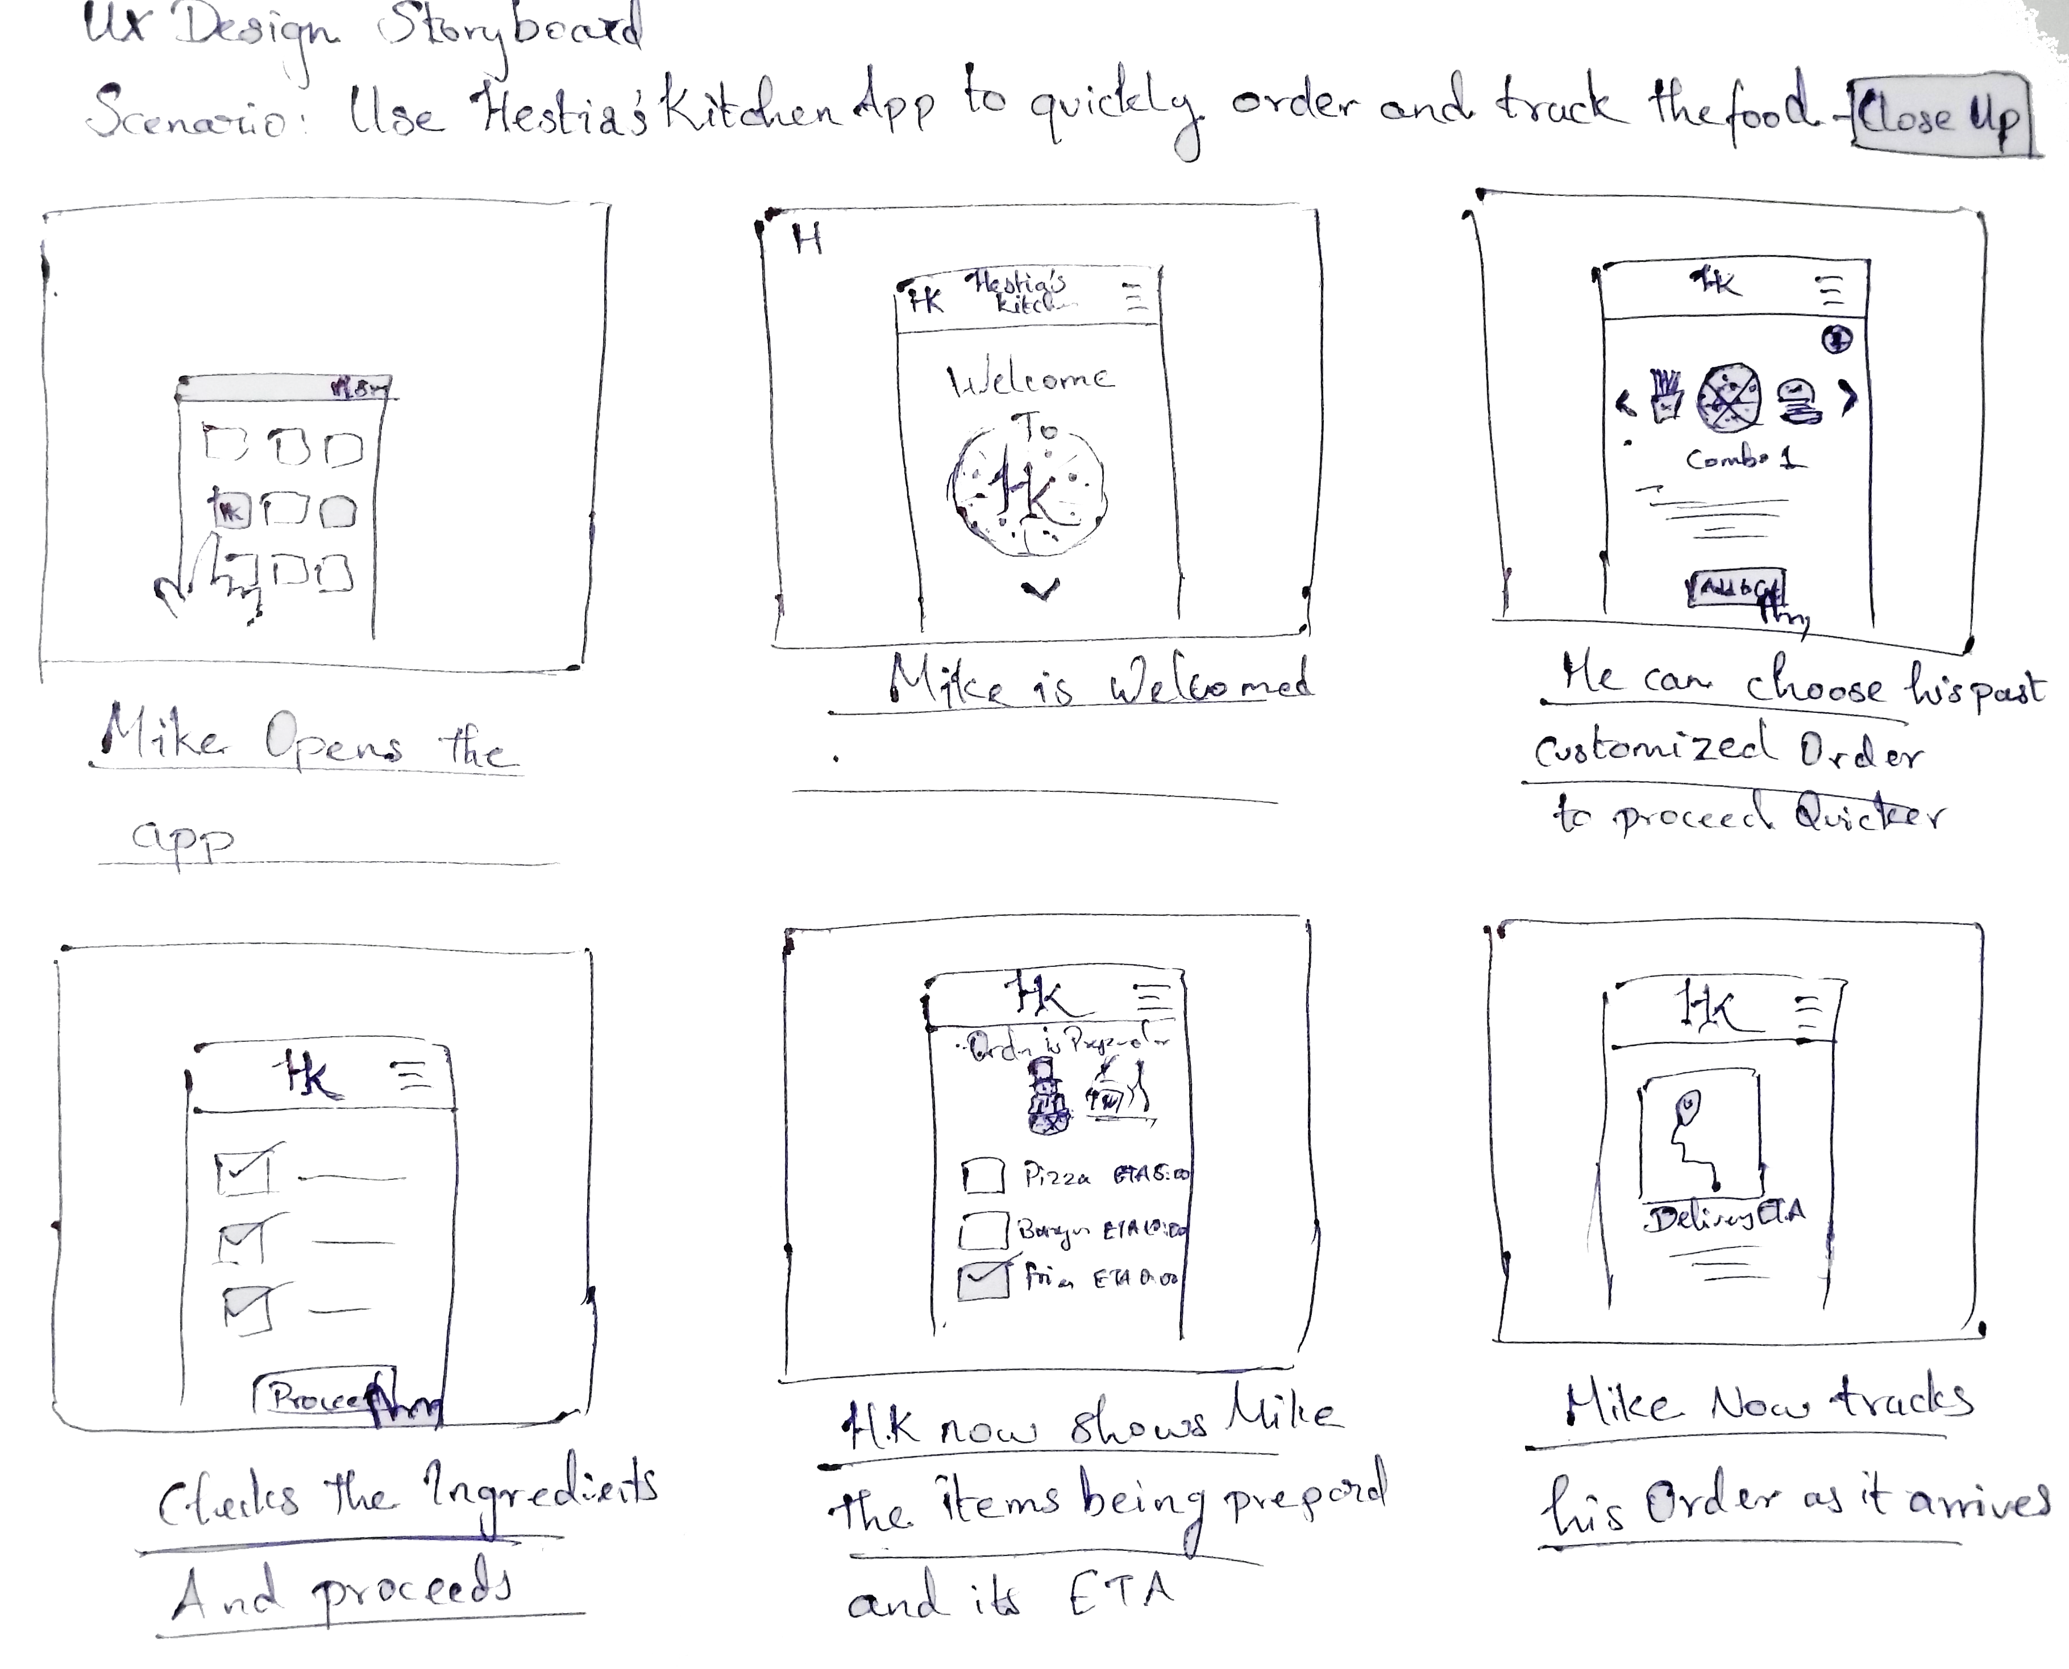
Paper wireframes
Big View : An story board of sketch for Mike ordering food from home with his colleagues.
Taking the time to draft iterations of each screen of the app on paper ensured that the elements that made it to digital wireframes would be well-suited to address user pain points. For the home screen, I prioritized a quick and easy ordering process to help users save time.
Close up :Stars were used to mark the elements of each sketch that would be used in the initial digital wireframes.

Slide 14
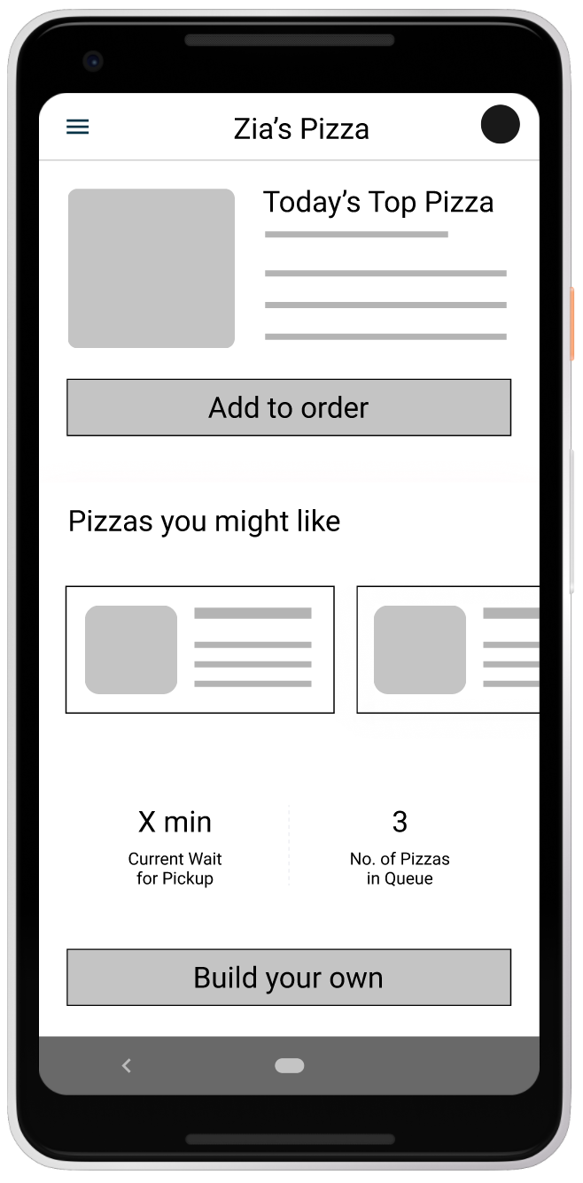
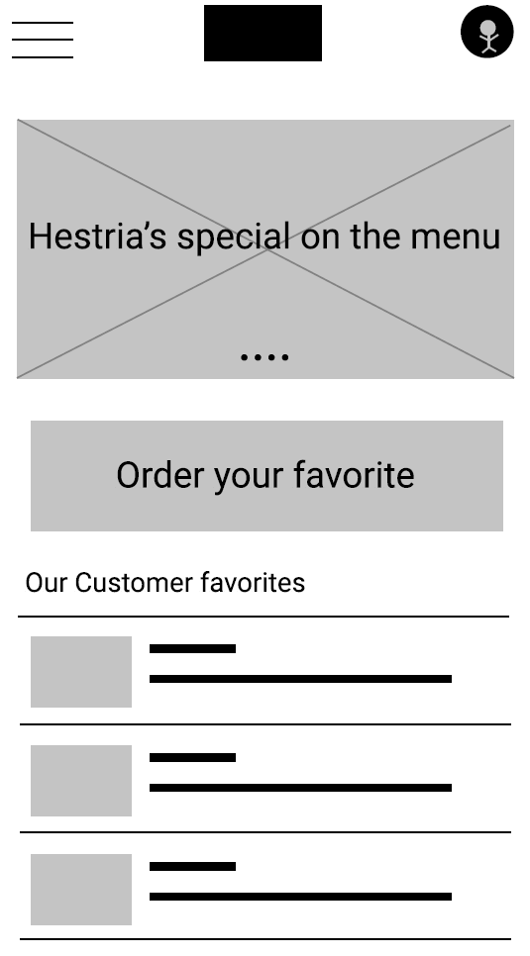
Digital wireframes
As the initial design phase continued, I made sure to base screen designs on feedback and findings from the user research.
This button at the top of the home screen makes it fast and easy for users to order.
This button provides an easy option for users to choose most ordered/favorite dish.

Slide 15
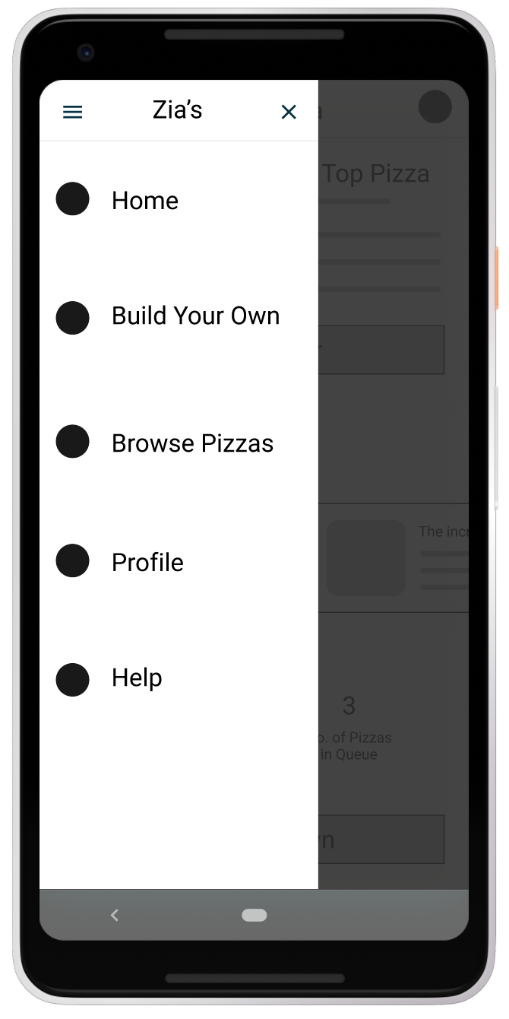
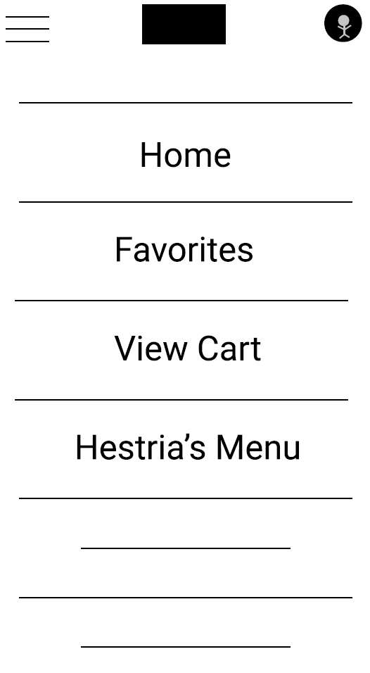
Digital wireframes
Easy access to navigation that’s screen reader friendly.
Easy navigation was a key user need to address in the designs in addition to equipping the app to work with assistive technologies.

Slide 16
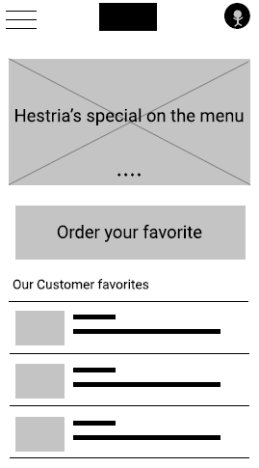
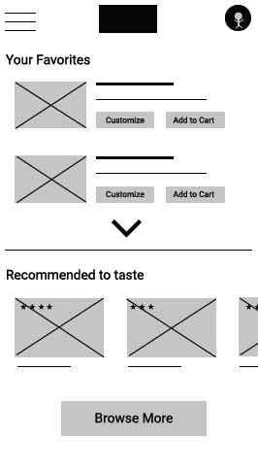
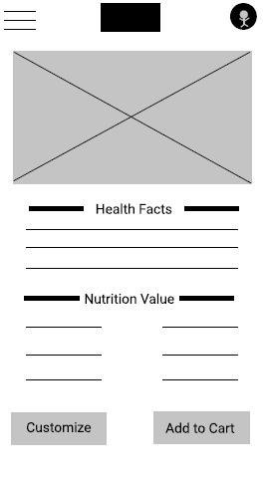
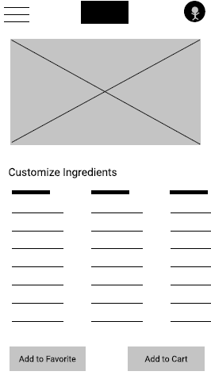
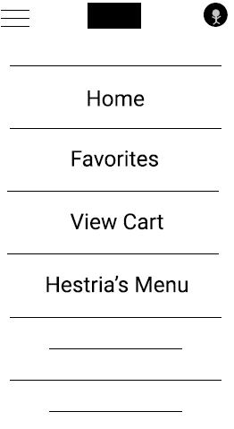
Low-fidelity prototype
Using the completed set of digital wireframes, I created a low-fidelity prototype. The primary user flow I connected was building and ordering a Italian dish, so the prototype could be used in a usability study.
View the Hestia’s Kitchen low-fidelity prototype

Slide 17
Usability study: findings
I conducted two rounds of usability studies. Findings from the first study helped guide the designs from wireframes to mockups. The second study used a high-fidelity prototype and revealed what aspects of the mockups needed refining.
Round 1 findings
Round 2 findings
1
Users want to order food quickly
1
The items in cart was not visible until checkout
Users want more customization options
Items already added to cart was not shown on the product
2
2
3
Users want a delivery Schedule option

Slide 18
Refining
the design
Mockups
High-fidelity prototype
Accessibility

Slide 19
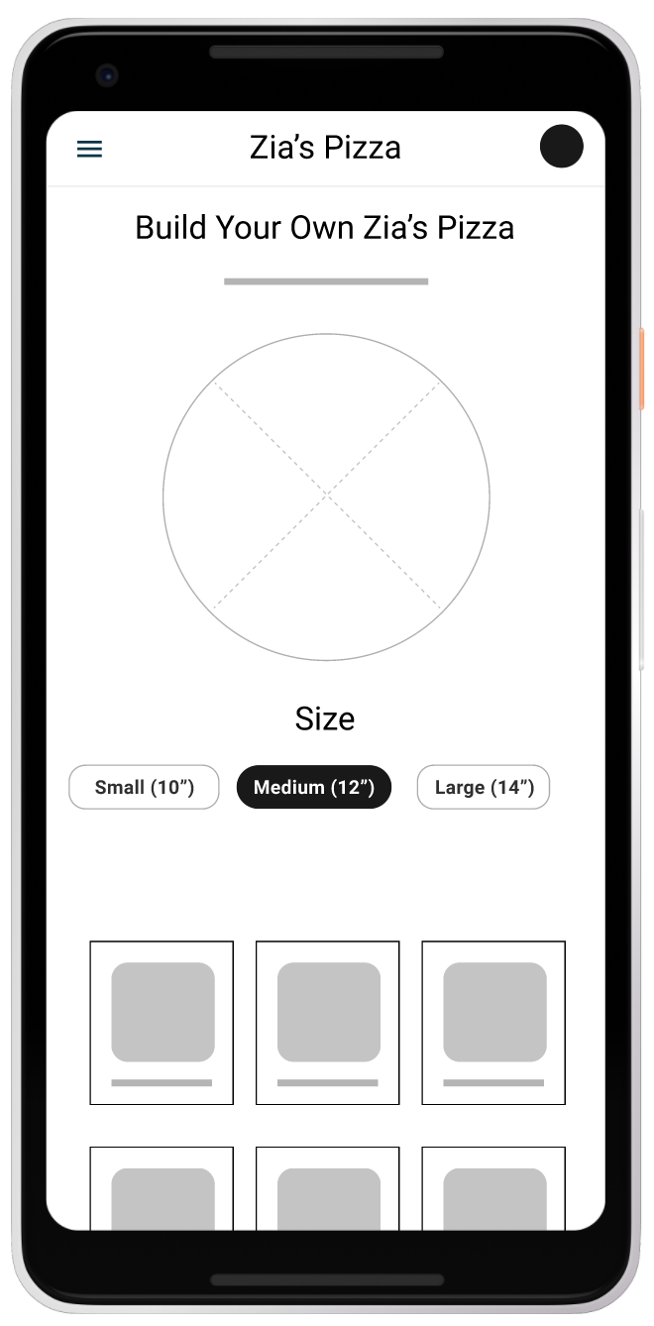
Mockups
Before usability studies
After usability studies
Early designs allowed for some customization, but after the usability studies, I added additional options to choose pizza crust and sauce. I also revised the design so users see all the customization options when they first land on the screen.

Slide 20
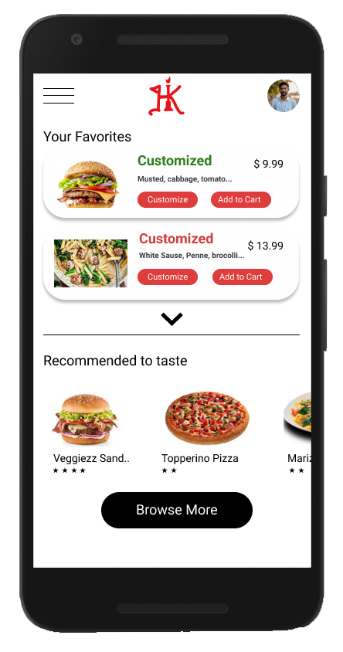
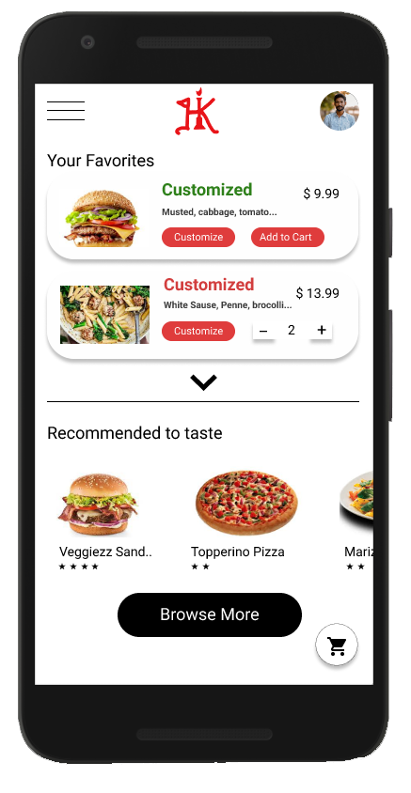
Mockups
The second usability study revealed frustration with the availablitly on items in cart , where users has to go through menu and click view cart to see the existing item quantity added to cart ,to streamline this flow, I consolidated by make this quantities available and also added a elevated cart icon to the bottom of screen.
Before usability study 2
After usability study 2

Slide 21
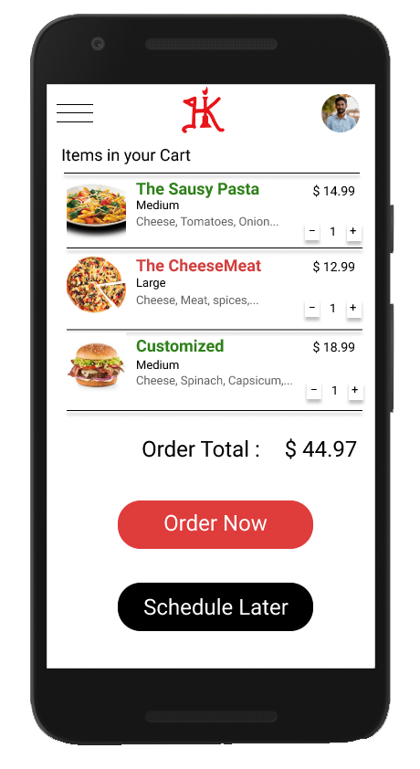
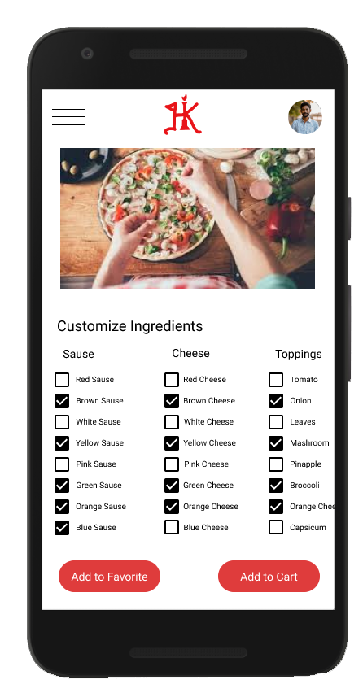
Key mockups

Slide 22
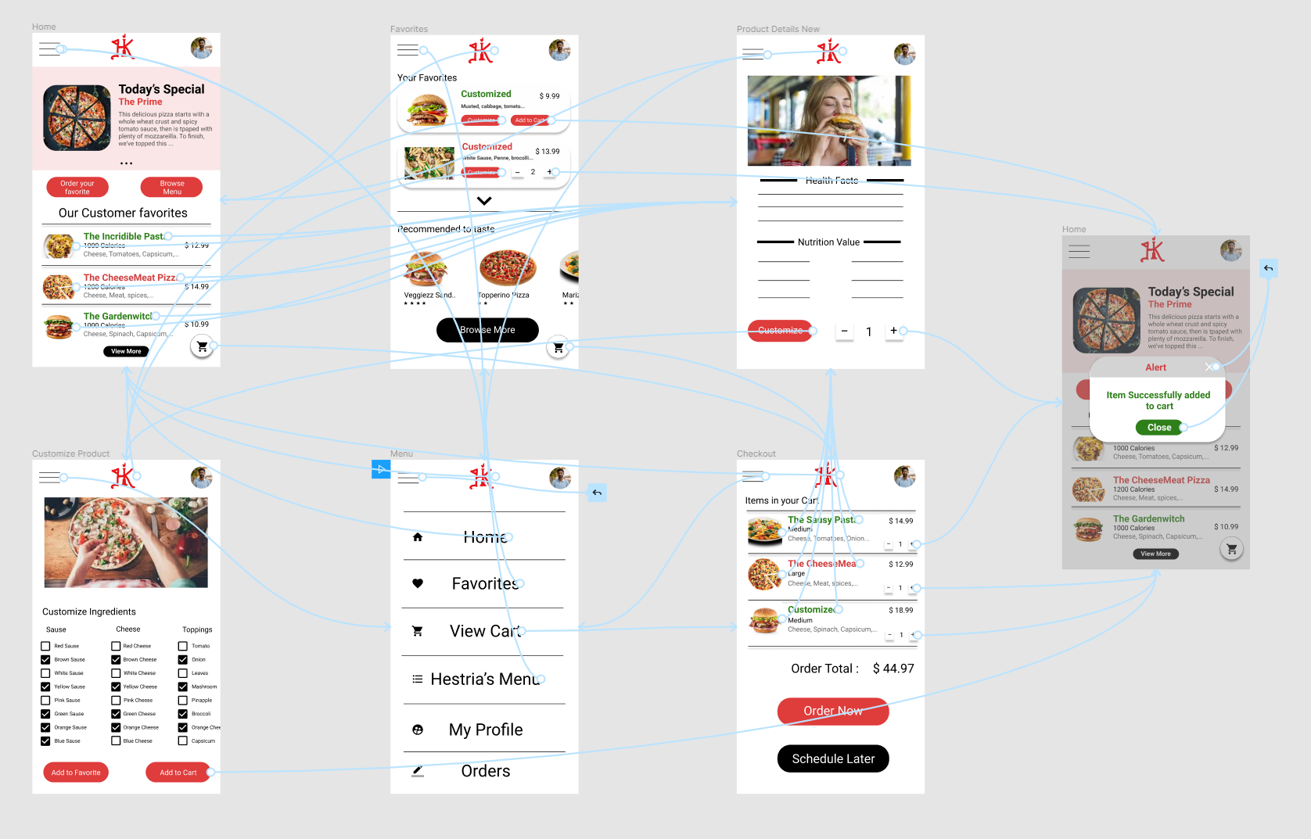
High-fidelity prototype
The final high-fidelity prototype presented cleaner user flows for ordering an dish and checkout. It also met user needs for a quick oand schedule delivery option as well as more customization.
View the Hestia’s Kicthen App high-fidelity prototype

Slide 23
Accessibility considerations
1
2
3
Provided access to users who are vision impaired through adding alt text to images for screen readers.
Used icons to help make navigation easier.
Used detailed imagery for burger, pizza and pasta toppings to help all users better understand the designs.

Slide 24
Going forward
Takeaways
Next steps

Slide 25
Takeaways
Impact:
The app makes users feel like Hestia’s Kitchen App really thinks about how to meet their needs.
One quote from peer feedback:
“The app made it so easy and fun to build my own Italian dish! I would definitely use this app as a go-to for a delicious, fast, and even happy meal.”
What I learned:
While designing the Hestia’s Kitchen app, I learned that the first ideas for the app are only the beginning of the process. Usability studies and peer feedback influenced each iteration of the app’s designs.

Slide 26
Next steps
1
2
Conduct another round of usability studies to validate whether the pain points users experienced have been effectively addressed.
Conduct more user research to determine any new areas of need.

Slide 27
Let’s connect!
Thank you for your time reviewing my work on the Hestia’s Kitchenapp! If you’d like to see more or get in touch, my contact information is provided below.
Email: amirtharajanpks@hotmail.com

Slide 28
Thank you!

